Slide 1

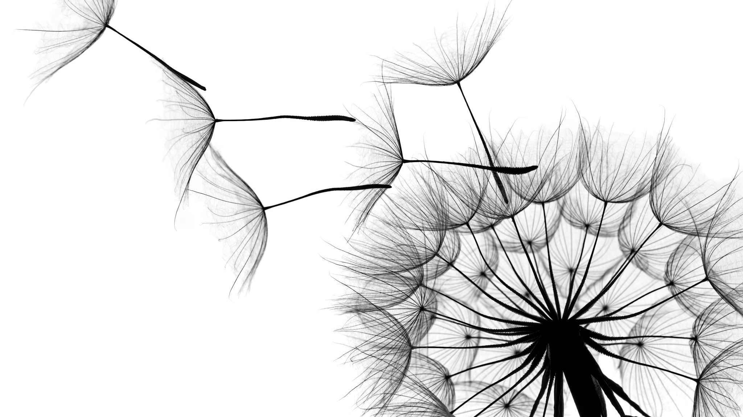
Project Report on Micro Credit Loan Defaulters
By Satyanath Das

Slide 2
Basic Introduction Of The Project
A Microfinance Institution (MFI) is an organization that offers financial services to low income populations. MFS becomes very useful when targeting especially the unbanked poor families living in remote areas with not much sources of income. The Microfinance services (MFS) provided by MFI are Group Loans, Agricultural Loans, Individual Business Loans and so on.
We are working with one such client that is in Telecom Industry. They are a fixed wireless telecommunications network provider. They have launched various products and have developed its business and organization based on the budget operator model, offering better products at Lower Prices to all value conscious customers through a strategy of disruptive innovation that focuses on the subscriber.
Our goal is here to make a best predictive model using Machine Learning in Python to find the Defaulters and Non Defaulters.

Slide 3
Problem Statement
Build a Classifier model which can be used to predict in terms of a probability for each loan transaction, whether the customer will be paying back the loaned amount within 5 days of issuance of loan.
The Consumer is believed to be defaulter if he deviates from the path of paying back the loaned amount within the time duration of 5 days. For the loan amount of 5 (in Indonesian Rupiah), payback amount should be 6 (in Indonesian Rupiah), while, for the loan amount of 10 (in Indonesian Rupiah), the payback amount should be 12 (in Indonesian Rupiah).
In this case, Label ‘1’ indicates that the loan has been payed i.e. Non- defaulter, while, Label ‘0’ indicates that the loan has not been payed i.e. defaulter.
In this project the sample data is provided to us from our client database. In order to improve the selection of users for the credit, the client wants some predictions that could help them in further investment and improvement in selection of users.
So we build a machine learning model that helps to understand the company that who is defaulter user and who is not based on the sample data

Slide 4
Data Preparation
First we import the dataset using the pd.read_csv method.Then we cheak the information about the dataset like how many rows and Columns are there , what are the data types of the columns.In this case there are 209593 Rows and 36 different Columns
Then we check for the null values present in our dataset. If null values are present then fill it via mean, median or mode. In this dataset no any null value present.We also use Heatmap to see the null values.
After that we check the summary statistics of our dataset. This part tells about the statistics of our dataset i.e. mean, median, max value ,min values,standard deviation and also it tell whether outliers are present in our dataset or not.In this dataset we saw that there are outliers available in most of the column.
We also cheak the correlation of the dataset.In this data set we saw most of the columns have little correlation with target column(‘label)

Slide 5
Exploring the data variable with respect to date gives us the information that, This data contains 3 months of information and when customers take loan.
We also checkd that there are some columns which have to relation with the output data. Either they are customer’s personal information or some extra labels.so we dropped those columns which have no relation with output data.
We also check the outliers with Zscore . Where Threshold value is 3.We try to remove the outliers for model’s better performance . But in this case the outliers are more than 20%.If we remove the outliers it will delete those rows and we lose the information of Defaulters and Non Defaulters

Slide 6
Visualization
We see the number of defaulter and non defaulter customers with the help of count plot.
We also see the distribution of the data with the help of dist plot whether it is left skewed or right skewed and for outliers use box plot.
We also use boxplot to see the how much Outliers are present in the data in Graphical form. We saw that outliers present in maximum column.
We plot correlation matrix via heat map to see the correlation of the columns with other columns.
We plot histogram for more information regarding to all Numerical Features.

Slide 7
Predictive Model Building
As we know that this problem is a classification type of problem.So I use Classification Algorithms like Logistic Regression, Random Forest Classifier, Kneighbors Classifier, Support Vector Classifier, Decision Tree Classifier, Gradient Boosting Classifier, AdaBoost Classifier.
This is a classification problem we use these matrics Accuracy Score, Classification Report, Confusion Matrix ,AUC ROC Score ,ROC Curve ,AUC.For avoiding Overfitting and Underfitting of the model I use Cross Validation Score.
I use Logistic Regression to find the best Random Number ranging from 1-100 for better accuracy score of the model.
After model traning and testing I found that Random forest Classifier performs well in this data set and It has 91% Accuracy Score and 91% Cross validation Score. So using the Joblib serialization method I save the model as pickle file.

Slide 8
Conclusion
We have learned to build a complete Machine Learning project Based on Classification(Defaulters and Non Defaulters).
In this project, sample data is provided to us. The user is supposed to be defaulter if he won’t pay back the loaned amount within the time duration of 5 days. I make a machine learning predective model in order to improve the selection of users for the loan. The client wants some predictions that could help them in further investment and improvement in selection of users and our model will help them.

